Slide 1
L7.3 Functional Approximation
Zonghua Gu 2021
Acknowledgement: slides based on https://www.coursera.org/specializations/reinforcement-learning
And textbook by Sutton and Barto http://incompleteideas.net/book/the-book-2nd.html

Slide 2
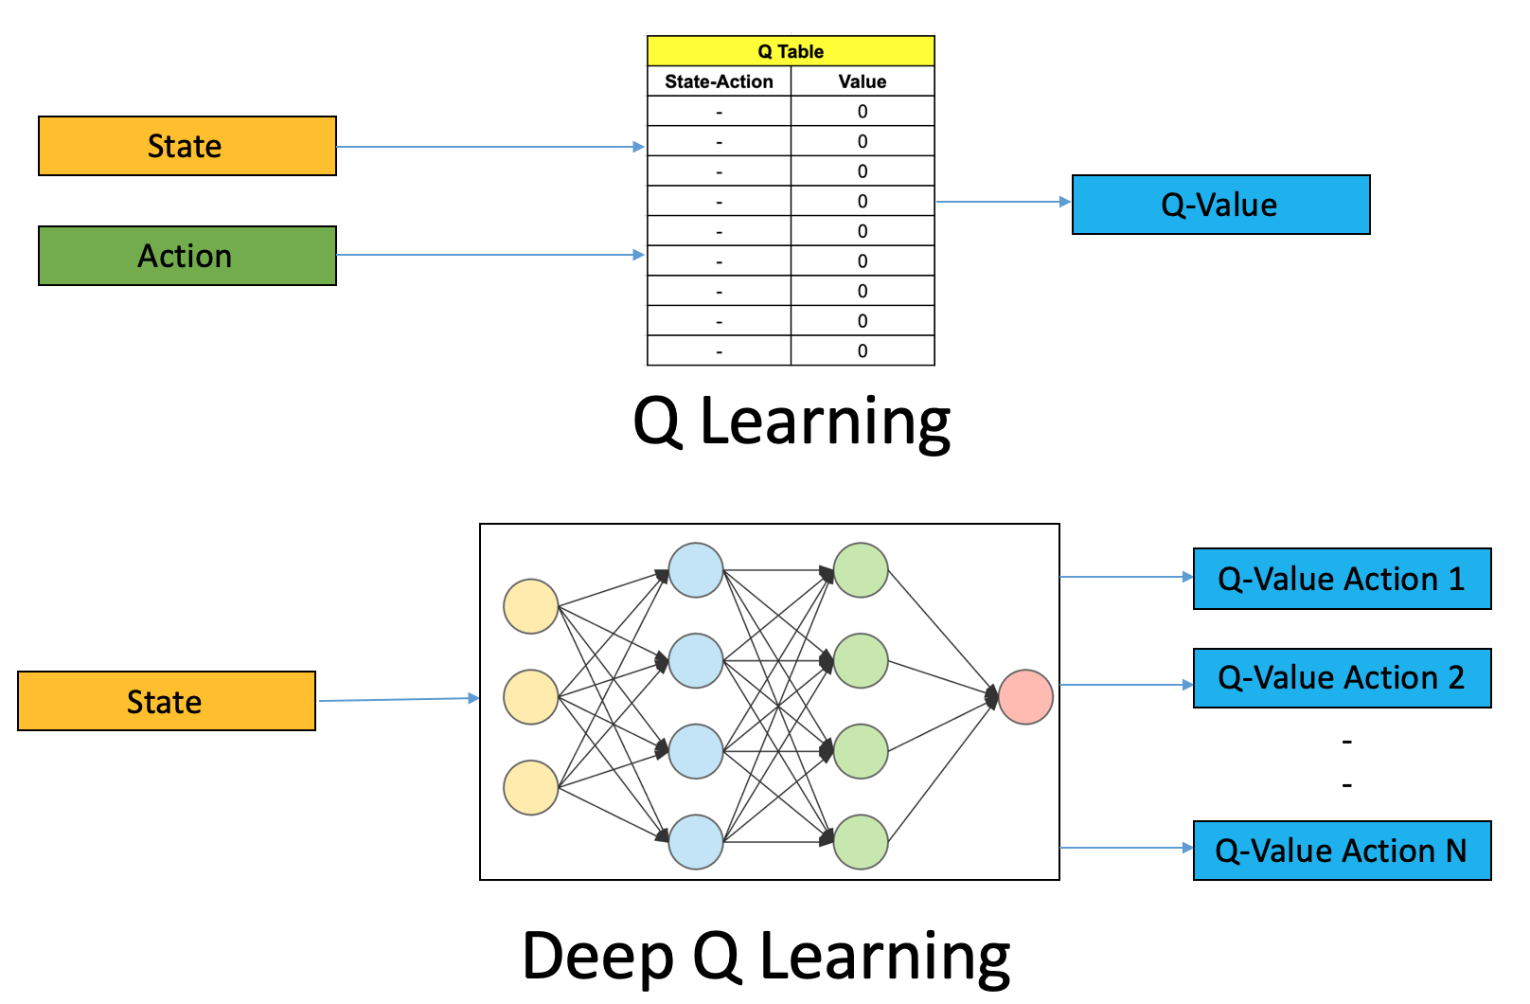
Q Learning vs. DQN
https://www.analyticsvidhya.com/blog/2019/04/introduction-deep-q-learning-python/

Slide 3
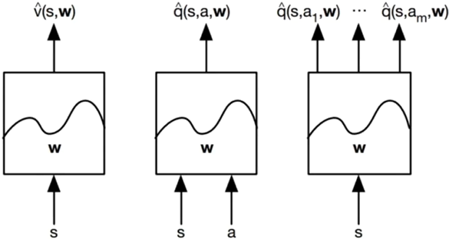
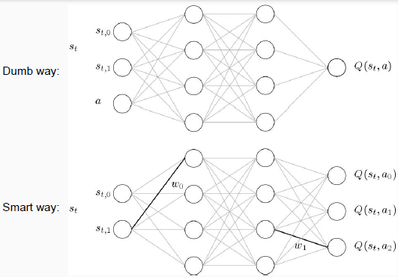
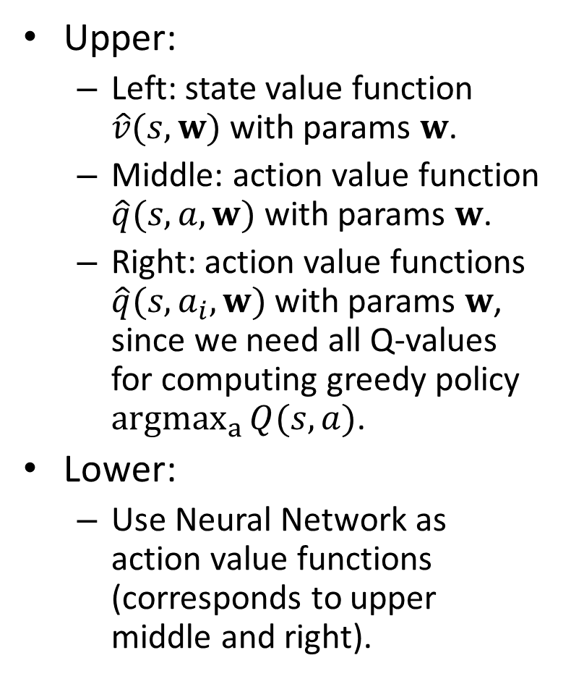
Function Approximations of Value Functions
Upper:
Left: state value function $\hat{v}(s,w)$ with params $w$.
Middle: action value function $\hat{q}(s,a,w)$ with params $w$.
Right: action value functions $\hat{q}(s,a_{i},w)$ with params $w$, since we need all Q-values for computing greedy policy ${argmax}_{a}{Q(s,a)}$.
Lower:
Use Neural Network as action value functions (corresponds to upper middle and right).

Slide 4
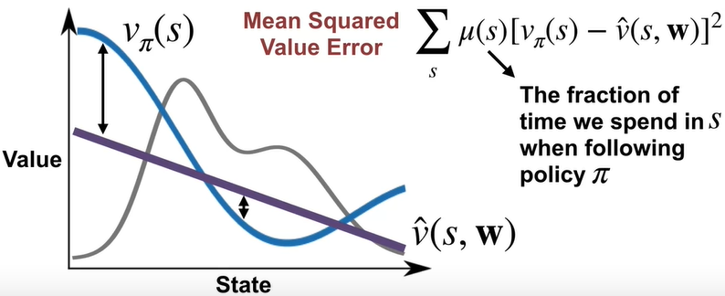
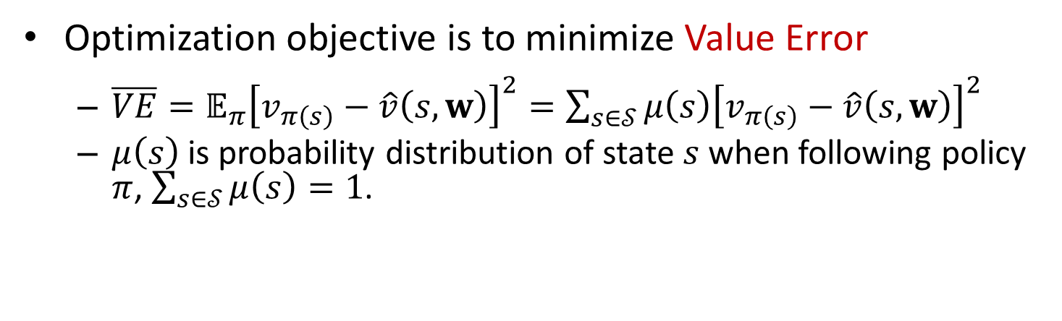
Mean Squared Error
Optimization objective is to minimize Value Error
$\overline{VE}=𝔼_{π}{\left[v_{π\left(s\right)}−\hat{v}\left(s,w\right)\right]}^{2}=\sum_{s∈𝒮}{μ\left(s\right){\left[v_{π\left(s\right)}−\hat{v}\left(s,w\right)\right]}^{2}}$
$μ\left(s\right)$ is probability distribution of state $s$ when following policy $π$, $\sum_{s∈𝒮}{μ\left(s\right)}=1$.
Notes:
i.e., fraction of time spent in each state $S$.

Slide 5
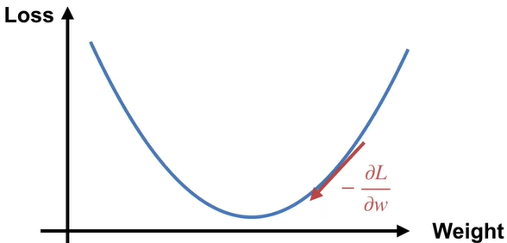
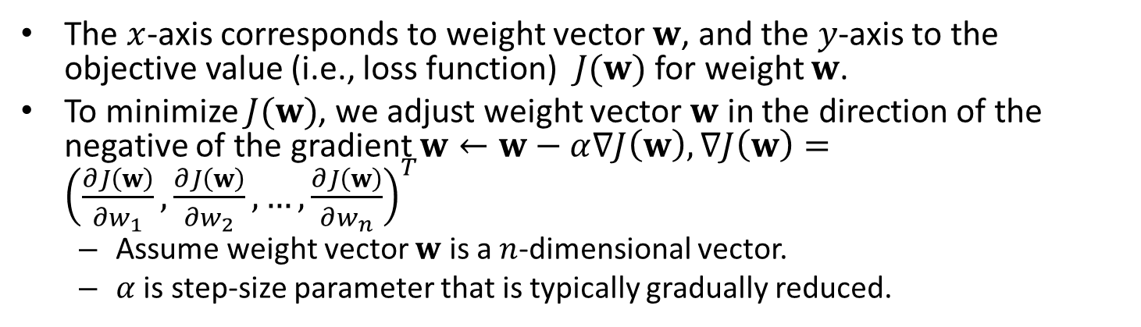

Gradient Descent (for General Function)
The $x$-axis corresponds to weight vector $w$, and the $y$-axis to the objective value (i.e., loss function) $J(w)$ for weight $w$.
To minimize $J(w)$, we adjust weight vector $w$ in the direction of the negative of the gradient $w←w−α∇J\left(w\right),∇J\left(w\right)={\left(\frac{∂J\left(w\right)}{∂w_{1}},\frac{∂J\left(w\right)}{∂w_{2}},…,\frac{∂J\left(w\right)}{∂w_{n}}\right)}^{T}$
Assume weight vector $w$ is a $n$-dimensional vector.
$α$ is step-size parameter that is typically gradually reduced.
$$J(w)$$
Notes:
Because we have a single weight,
this means our gradient is just a scalar derivative.

Slide 6
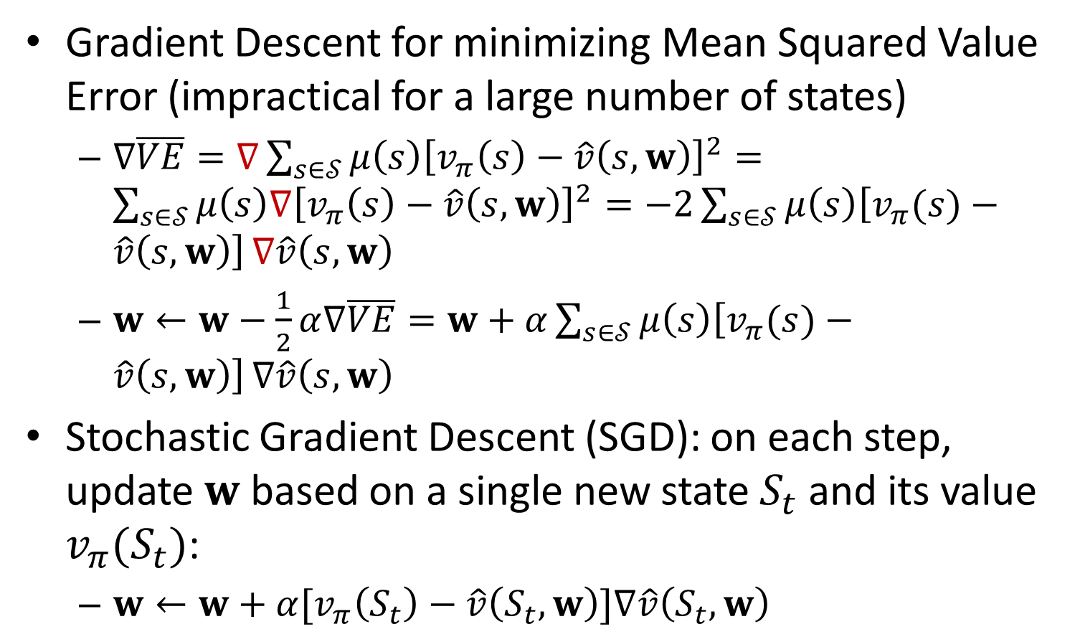
Stochastic Gradient Descent (SGD)
Gradient Descent for minimizing Mean Squared Value Error (impractical for a large number of states)
$∇\overline{VE}=∇\sum_{s∈𝒮}{μ\left(s\right){\left[v_{π}\left(s\right)−\hat{v}\left(s,w\right)\right]}^{2}}=\sum_{s∈𝒮}{μ\left(s\right){∇\left[v_{π}\left(s\right)−\hat{v}\left(s,w\right)\right]}^{2}}=−2\sum_{s∈𝒮}{μ\left(s\right)\left[v_{π}(s)−\hat{v}\left(s,w\right)\right]}∇\hat{v}\left(s,w\right)$
$w←w−\frac{1}{2}α∇\overline{VE}=w+α\sum_{s∈𝒮}{μ\left(s\right)\left[v_{π}(s)−\hat{v}\left(s,w\right)\right]}∇\hat{v}\left(s,w\right)$
Stochastic Gradient Descent (SGD): on each step, update $w$ based on a single new state $S_{t}$ and its value $v_{π}{(S}_{t})$:
$w←w+α[v_{π}\left(S_{t}\right)−\hat{v}\left(S_{t},w\right)]∇\hat{v}\left(S_{t},w\right)$
Notes:
that is gradually reduced

Slide 7
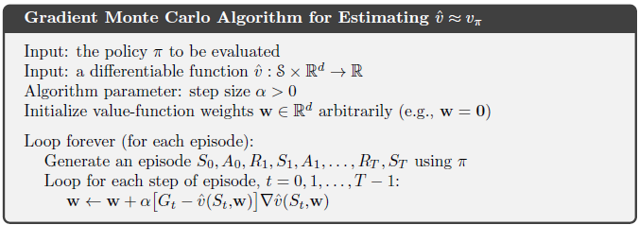

Gradient Monte Carlo
Gradient Monte Carlo: Use MC target $G_{t}$ as unbiased estimate of $v_{π}\left(S_{t}\right)$.
$w←w+α[G_{t}−\hat{v}\left(S_{t},w\right)]∇\hat{v}\left(S_{t},w\right)$
Recall $G_{t}≐\sum_{k=0}^{T−1}{γ^{k}}R_{t+k+1}$

Slide 8
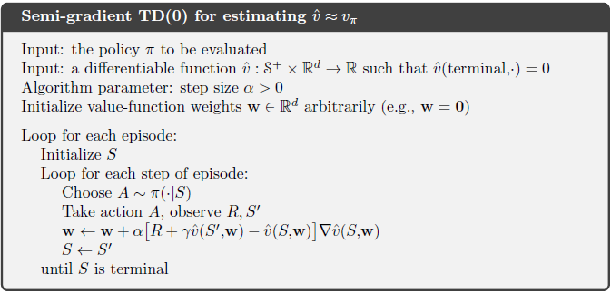
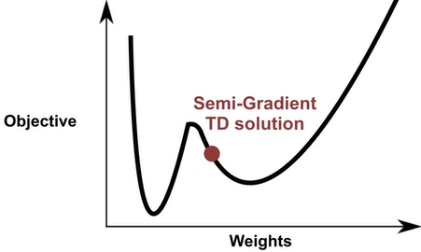
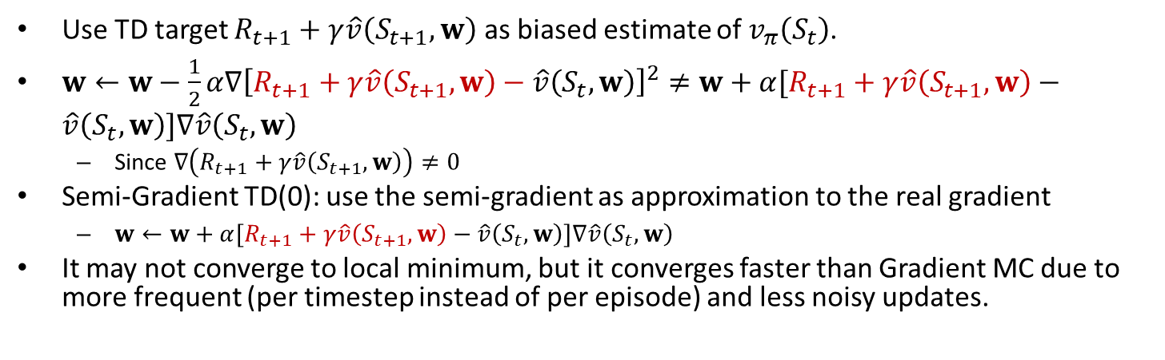
Semi-Gradient TD(0)
Use TD target $R_{t+1}+γ\hat{v}\left(S_{t+1},w\right)$ as biased estimate of $v_{π}\left(S_{t}\right)$.
$w←w−\frac{1}{2}α∇{\left[R_{t+1}+γ\hat{v}\left(S_{t+1},w\right)−\hat{v}\left(S_{t},w\right)\right]}^{2}≠w+α[R_{t+1}+γ\hat{v}\left(S_{t+1},w\right)−\hat{v}\left(S_{t},w\right)]∇\hat{v}\left(S_{t},w\right)$
Since $∇\left(R_{t+1}+γ\hat{v}\left(S_{t+1},w\right)\right)≠0$
Semi-Gradient TD(0): use the semi-gradient as approximation to the real gradient
$w←w+α[R_{t+1}+γ\hat{v}\left(S_{t+1},w\right)−\hat{v}\left(S_{t},w\right)]∇\hat{v}\left(S_{t},w\right)$
It may not converge to local minimum, but it converges faster than Gradient MC due to more frequent (per timestep instead of per episode) and less noisy updates.

Slide 9
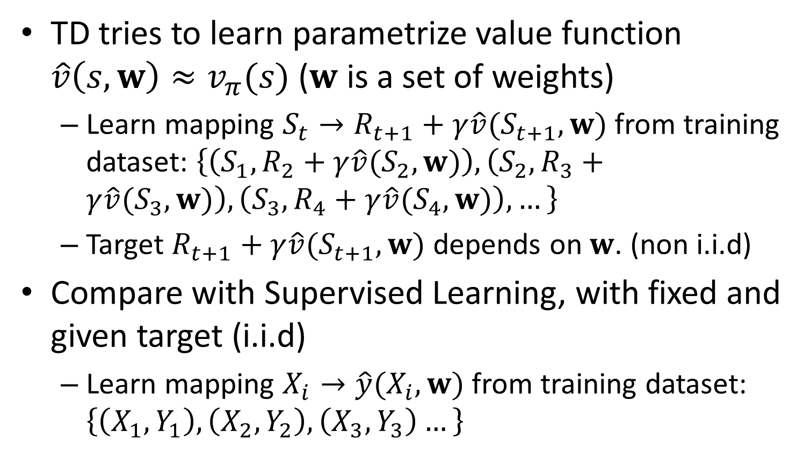
TD vs. Supervised Learning
TD tries to learn parametrize value function $\hat{v}\left(s,w\right)≈v_{π}(s)$ ($w$ is a set of weights)
Learn mapping $S_{t}→R_{t+1}+γ\hat{v}(S_{t+1},w)$ from training dataset: $\left\{\left(S_{1},R_{2}+γ\hat{v}(S_{2},w)\right),\left(S_{2},R_{3}+γ\hat{v}(S_{3},w)\right),\left(S_{3},R_{4}+γ\hat{v}(S_{4},w)\right),…\right\}$
Target $R_{t+1}+γ\hat{v}(S_{t+1},w)$ depends on $w$. (non i.i.d)
Compare with Supervised Learning, with fixed and given target (i.i.d)
Learn mapping $X_{i}→\hat{y}(X_{i},w)$ from training dataset: $\left\{\left(X_{1},Y_{1}\right),\left(X_{2},Y_{2}\right),\left(X_{3},Y_{3}\right)…\right\}$
Notes:
Monte-Carlo: $\left\{\left(S_{1},G_{1}\right),\left(S_{2},G_{2}\right),\left(S_{1},G_{3}\right),…\right\}$ Policy Evaluation vs. Supervised Learning
Recall tabular TD:
$$V\left(S_{t}\right)←V\left(S_{t}\right)+α(R_{t+1}+γV\left(S_{t+1}\right)−V(S_{t}))$$

Slide 10
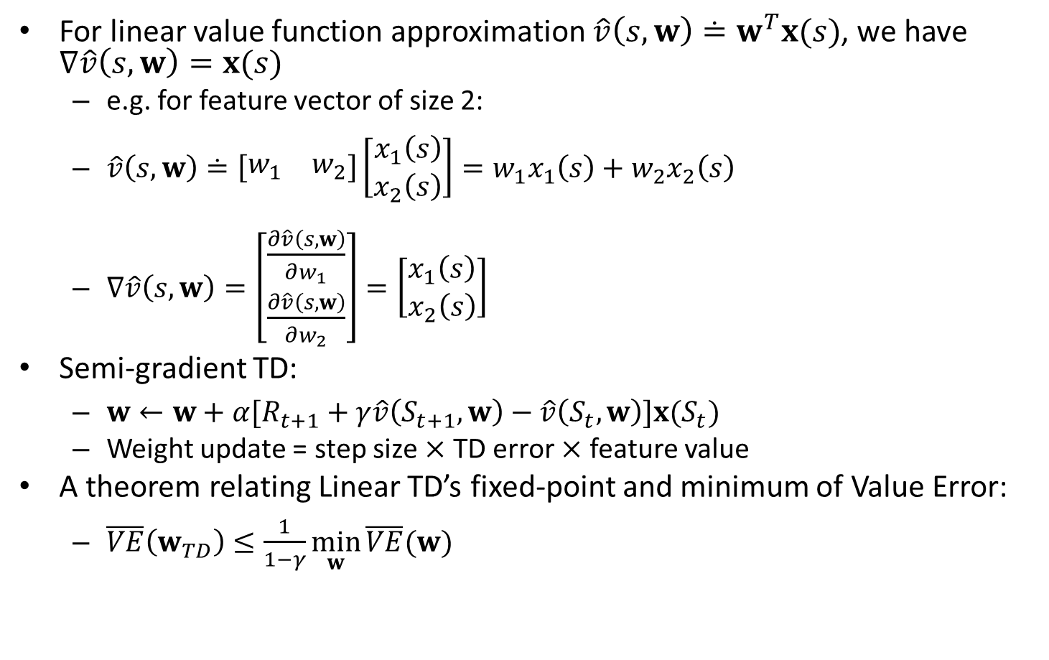
TD w. Linear Function Approximation
For linear value function approximation $\hat{v}\left(s,w\right)≐w^{T}x(s)$, we have $∇\hat{v}\left(s,w\right)=x(s)$
e.g. for feature vector of size 2:
$\hat{v}\left(s,w\right)≐\left[\begin{matrix}w_{1} & w_{2}\end{matrix}\right]\left[\begin{matrix}x_{1}\left(s\right) \\ x_{2}\left(s\right)\end{matrix}\right]=w_{1}x_{1}\left(s\right)+w_{2}x_{2}\left(s\right)$
$∇\hat{v}\left(s,w\right)=\left[\begin{matrix}\frac{∂\hat{v}\left(s,w\right)}{∂w_{1}} \\ \frac{∂\hat{v}\left(s,w\right)}{∂w_{2}}\end{matrix}\right]=\left[\begin{matrix}x_{1}\left(s\right) \\ x_{2}\left(s\right)\end{matrix}\right]$
Semi-gradient TD:
$w←w+α[R_{t+1}+γ\hat{v}\left(S_{t+1},w\right)−\hat{v}\left(S_{t},w\right)]x(S_{t})$
Weight update = step size $×$ TD error $×$ feature value
A theorem relating Linear TD’s fixed-point and minimum of Value Error:
$\overline{VE}\left(w_{TD}\right)≤\frac{1}{1−γ}\min_{w}{\overline{VE}(w)}$
Notes:
($γ$ is discount factor)

Slide 11
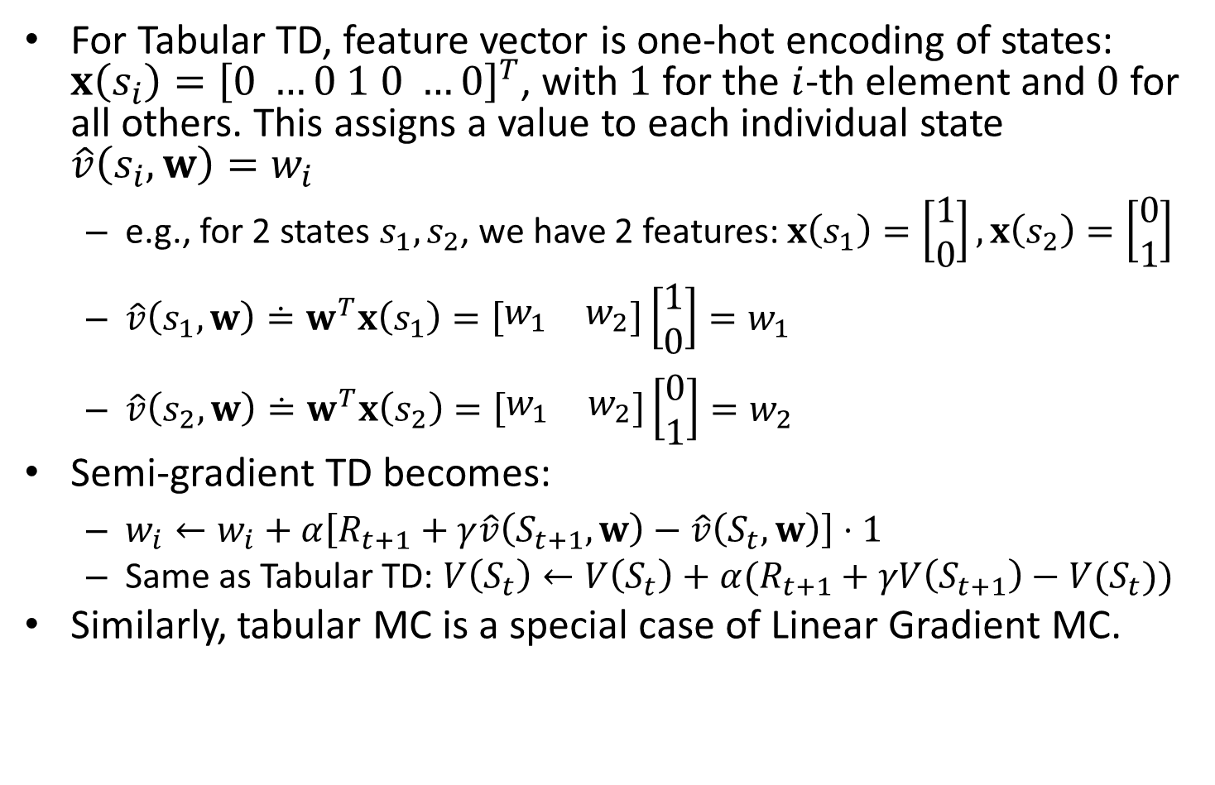
Tabular TD is a Special Case of Linear TD
For Tabular TD, feature vector is one-hot encoding of states: ${x\left(s_{i}\right)=\left[0 …0 1 0 …0\right]}^{T}$, with $1$ for the $i$-th element and $0$ for all others. This assigns a value to each individual state $\hat{v}\left(s_{i},w\right)=w_{i}$
e.g., for 2 states $s_{1},s_{2}$, we have 2 features: $x\left(s_{1}\right)=\left[\begin{matrix}1 \\ 0\end{matrix}\right],x\left(s_{2}\right)=\left[\begin{matrix}0 \\ 1\end{matrix}\right]$
$\hat{v}\left(s_{1},w\right)≐w^{T}x\left(s_{1}\right)=\left[\begin{matrix}w_{1} & w_{2}\end{matrix}\right]\left[\begin{matrix}1 \\ 0\end{matrix}\right]=w_{1}$
$\hat{v}\left(s_{2},w\right)≐w^{T}x\left(s_{2}\right)=\left[\begin{matrix}w_{1} & w_{2}\end{matrix}\right]\left[\begin{matrix}0 \\ 1\end{matrix}\right]=w_{2}$
Semi-gradient TD becomes:
$w_{i}←w_{i}+α\left[R_{t+1}+γ\hat{v}\left(S_{t+1},w\right)−\hat{v}\left(S_{t},w\right)\right]⋅1$
Same as Tabular TD: $V\left(S_{t}\right)←V\left(S_{t}\right)+α(R_{t+1}+γV\left(S_{t+1}\right)−V(S_{t}))$
Similarly, tabular MC is a special case of Linear Gradient MC.

Slide 12
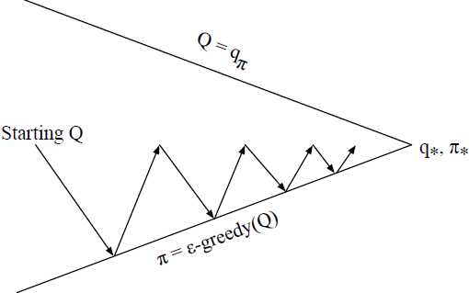
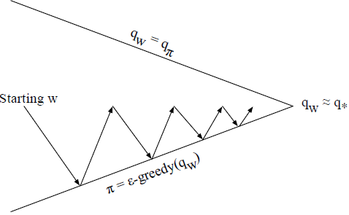
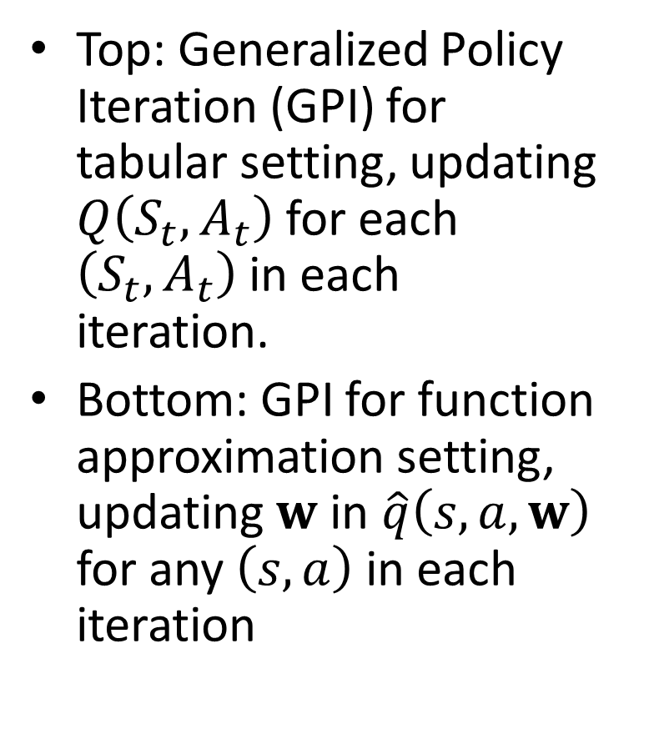
CH10 On-policy Control with Approximation
Top: Generalized Policy Iteration (GPI) for tabular setting, updating $Q\left(S_{t},A_{t}\right)$ for each $\left(S_{t},A_{t}\right)$ in each iteration.
Bottom: GPI for function approximation setting, updating $w$ in $\hat{q}\left(s,a,w\right)$ for any $\left(s,a\right)$ in each iteration

Slide 13
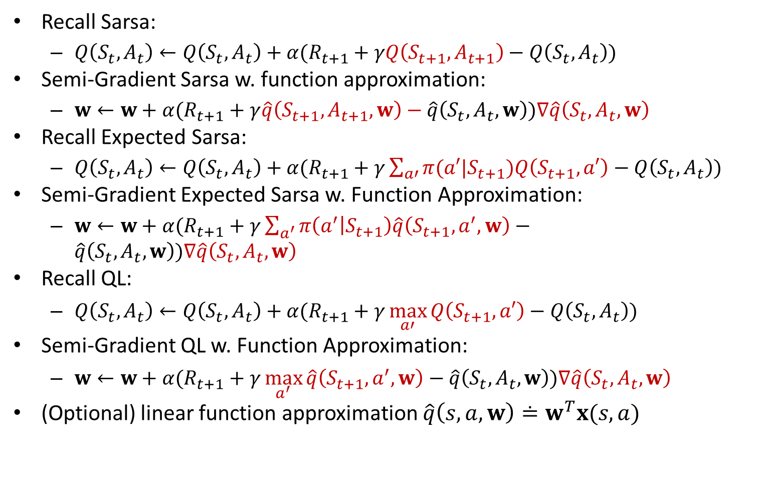
Action Value Function Update Equations
Recall Sarsa:
$Q\left(S_{t},A_{t}\right)←Q\left(S_{t},A_{t}\right)+α(R_{t+1}+γQ\left(S_{t+1},A_{t+1}\right)−Q\left(S_{t},A_{t}\right))$
Semi-Gradient Sarsa w. function approximation:
$w←w+α(R_{t+1}+γ\hat{q}\left(S_{t+1},A_{t+1},w\right)−\hat{q}\left(S_{t},A_{t},w\right))∇\hat{q}\left(S_{t},A_{t},w\right)$
Recall Expected Sarsa:
$Q\left(S_{t},A_{t}\right)←Q\left(S_{t},A_{t}\right)+α(R_{t+1}+γ\sum_{a′}{π(a′|S_{t+1})Q\left(S_{t+1},a′\right)}−Q\left(S_{t},A_{t}\right))$
Semi-Gradient Expected Sarsa w. Function Approximation:
$w←w+α(R_{t+1}+γ\sum_{a^{′}}{π\left(a^{′} | S_{t+1}\right)\hat{q}\left(S_{t+1},a^{′},w\right)}−\hat{q}\left(S_{t},A_{t},w\right))∇\hat{q}\left(S_{t},A_{t},w\right)$
Recall QL:
$Q\left(S_{t},A_{t}\right)←Q\left(S_{t},A_{t}\right)+α(R_{t+1}+γ\max_{a′}{Q\left(S_{t+1},a′\right)}−Q\left(S_{t},A_{t}\right))$
Semi-Gradient QL w. Function Approximation:
$w←w+α(R_{t+1}+γ\max_{a^{′}}{\hat{q}\left(S_{t+1},a^{′},w\right)}−\hat{q}\left(S_{t},A_{t},w\right))∇\hat{q}\left(S_{t},A_{t},w\right)$
(Optional) linear function approximation $\hat{q}\left(s,a,w\right)≐w^{T}x(s,a)$
Notes:
Recall Semi-Gradient TD(0): $w←w+α[R_{t+1}+γ\hat{v}\left(S_{t+1},w\right)−\hat{v}\left(S_{t},w\right)]∇\hat{v}\left(S_{t},w\right)$

